Slide 1
H.264 Video Encoding
H.264 is a video compression standard and format that uses advanced compression techniques to deliver high-quality video at low bit rates.
It is part of the MPEG-4 standard and is also known as MPEG-4 Part 10, Advanced Video Coding (AVC).
H.264 is a lossy compression format, meaning it selectively removes data that is not essential to human perception, allowing for significant file size reductions while maintaining visual quality.

Slide 2
Main Goal Of H.264
To provide high-quality video compression (video coding) at -
1)Low bitrate
2)Low Bandwidth Usage
3)Low Storage Demand

Slide 3
How we can provide High-quality video
This are the factors/parameter we can control and Provide high quality video
adjust settings and parameters to get the best balance between video quality
1.Bitrate
2.Profile
3.Resolution
4.KeyFrame Interval
5.B-Frame

Slide 4
Best Practices for H.264 Video Encoding
Optimize bitrate for your target audience
Bitrate: Choose the appropriate bitrate based on the desired output quality and the target audience’s bandwidth. A higher bitrate results in better video quality, but requires more bandwidth to stream.
Bitrate – Choose the Right Data Rate
Bitrate is the amount of data used per second of video (usually in kbps or Mbps).
A higher bitrate = better quality, but uses more internet data and storage.
A lower bitrate = smaller file size, but lower quality.
Best Practice: Choose bitrate based on:
Target audience’s internet speed
Video content type (e.g., fast-moving scenes need higher bitrate)

Slide 5
Types Of Bitrate:.
1. Constant Bitrate (CBR)
The encoder keeps the bitrate the same throughout the entire video.
Use case:
Live streaming
Real-time broadcasting
Pros:
Predictable bandwidth usage
Cons:
May waste bandwidth on simple scenes
May reduce quality in complex scenes
Example: Fixed at 5 Mbps for a 1080p livestream.

Slide 6
2. Variable Bitrate (VBR)
Bitrate changes depending on scene complexity.
Use case:
Offline encoding
When quality is a priority
Pros:
Better overall quality at lower average bitrate
Cons:
File size is less predictable
Not ideal for real-time streaming
Example: Bitrate varies between 2 Mbps (static scenes) and 8 Mbps (fast scenes).

Slide 7
3. Average Bitrate (ABR)
A form of VBR where the encoder targets an average bitrate over the whole video.
Use case:
Offline encoding with some control over file size
Pros:
Better than CBR in terms of quality
File size is more predictable than VBR
Cons:
Still less precise than CBR
Example: Target average of 6 Mbps for a 1080p video, but with small fluctuations.

Slide 8
4. Constant Rate Factor (CRF) (specific to x264)
Quality-based encoding mode. You set a quality level, and bitrate is adjusted automatically.
Use case:
Encoding for quality-first scenarios (e.g., archival, YouTube)
Pros:
Consistent visual quality
Very efficient for storage
Cons:
File size and bitrate are not fixed
Example: CRF 23 in x264 gives a balance of quality and file size.
A quality-based encoding mode: you set a CRF value (0–51).
Lower CRF = better quality = higher file size.
Bitrate changes to maintain that visual quality.
Typical values:
CRF 18–23 for good quality
CRF 28+ for smaller size but lower quality

Slide 9
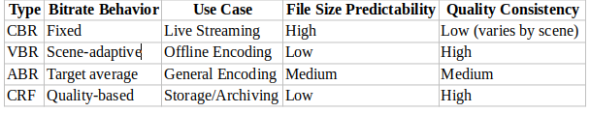

Slide 10
2. Profile – Choose the Right Encoding Profile
You can think of the profile as the level of complexity required in encode / decode.
In video encoding, especially with H.264, a profile defines a set of features and capabilities the encoder and decoder will use. Think of a profile like a “mode” or “preset” that balances compression efficiency, compatibility, and video quality.
H.264 has profiles: Baseline, Main, High, etc. These define how advanced the compression features are.
Best Practice:
Use Baseline Profile for mobile devices and web streaming (widely supported).
Use Main or High Profile for higher quality videos on more powerful devices.
Example: YouTube often uses High Profile for best compression and quality.

Slide 11
Common H.264 Profiles
1. Baseline Profile
Target: Low-power devices like mobile phones, video calls
Supports: Basic compression (I-frames, P-frames)
No advanced features like B-frames.
Use case: Video conferencing, live streaming on low-end devices
2. Main Profile
Target: Standard-definition to HD video playback and streaming
Supports: B-frames, interlaced video, more efficient than Baseline
Not as efficient as High Profile
Use case: Broadcast TV, set-top boxes, streaming platforms
3. High Profile
Target: YouTube, professional content
Supports: 8x8 transform, more advanced compression
Use case: YouTube, Netflix

Slide 12
Profile | Best For | Features | Device Support
Baseline | Mobile, low-power, video calls | Simple features only | Very high (universal)
Main | TV, streaming, | B-frames, better compression | High
High | YouTube, editing | Best compression, high quality | High (modern only)
Real-world Example:
A Zoom call on an old phone might use Baseline.
A Netflix show streamed in HD might use Main.
A YouTube 4K video will use High Profile for best compression and quality.

Slide 13
3.Resolution – Balance Quality and File Size
Resolution is the size of the video frame (e.g., 1920x1080 for 1080p).
Higher resolution = better clarity, but more data and storage.
Best Practice:
Choose resolution based on:
Screen size
Available bandwidth
Content type
Example: For low-speed networks, use 480p instead of 1080p to avoid buffering.

Slide 14
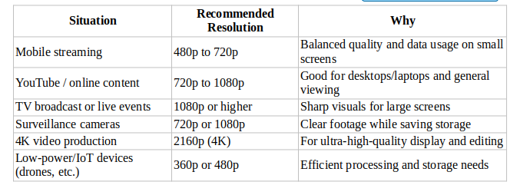
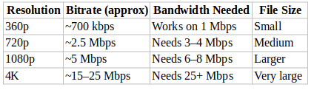

Slide 15
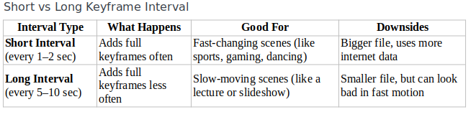
4.Keyframe Interval
The keyframe interval is how often you insert a full image (keyframe) into the video.
Example:
If your video runs at 30 frames per second (fps), and you set a keyframe interval of:
60 frames → That means a full keyframe is added every 2 seconds (60 ÷ 30 = 2).
150 frames → A keyframe every 5 seconds (150 ÷ 30 = 5).

Slide 16
5. Adaptive Bitrate Streaming: Use adaptive bitrate streaming to dynamically adjust the bitrate of the video based on the viewer’s bandwidth. This ensures that the viewer receives the best quality video possible given their connection speed.
6. Video Filter: Use video filters to improve the quality of the video. For example, use de-noise filters to reduce noise in the video, or use sharpening filters to enhance the sharpness of the image.
7.Testing: Test the encoded video on a variety of devices and networks to ensure that the video is of sufficient quality and can be played back seamlessly.
8. Container: additionally, selecting the appropriate container format when encoding H.264 files is crucial. MP4 is the most widely supported format, while MOV and MKV provide advanced features for specific use cases.

Slide 17
optimize H.264 video encoding:
1.Optimize bitrate for your target audience
Select a bitrate that balances quality and file size based on your audience’s expected bandwidth
2.Match H.264 profile to your use case
Choose the appropriate H.264 profile—Baseline, Main, or High—depending on your application.
3.Tune resolution based on content and platform
Use the resolution that best fits the viewing platform.
4. Set a balanced keyframe interval
Adjust the keyframe interval based on the content’s nature.
5. Leverage B-frames for better compression
Enable B-frames to improve compression efficiency, especially for complex scenes.
6. Use adaptive bitrate streaming (ABR)
Implement ABR to dynamically adjust video quality based on the viewer’s connection.
7. Enhance video quality with filters
Apply filters like denoising and sharpening to improve the visual quality of your video.

Slide 18
levels
In H.264 (AVC), levels define the performance requirements and limits of the decoder or encoder. They specify constraints on things like:
Resolution
Bitrate
Frame rate
Macroblocks per second
Decoded picture buffer size
Purpose of Levels:
To ensure interoperability between devices (e.g., a phone can declare it supports "Level 3.1").
To match the hardware or decoder capability to video complexity.
For example:
A video encoded with High Profile, Level 4.1 supports Full HD with advanced compression, but a device that only supports Baseline, Level 3.0 cannot decode it.

Slide 19
